Slide 1
Shaheed Bhagat Singh State Technical Campus
PTU JALANDHAR AFFILIATED
(ESTABLISHED BY PUNJAB GOVERNMENT IN 1995)
Moga Road(NH-95),Ferozepur(Pb),India
AICTE APPROVED
PTU JALANDHAR AFFILIATED
(ESTABLISHED BY PUNJAB GOVERNMENT IN 1995)

Slide 2
Campus overview
The Institute was established by the Government of Punjab in 1995 with the name Shaheed Bhagat Singh College of Engineering & Technology as a tribute to the great martyr Shaheed Bhagat Singh.
In the academic year 2011-12, it was upgraded to the status of a technical campus and rechristened as Shaheed Bhagat Singh State Technical Campus, Ferozepur .
The Technical Campus, with its lush green state-of-the-art campus spread over 98 acres is situated on Ferozepur-Moga Road, about four Kilometers away from the Ferozepur city.

Slide 3
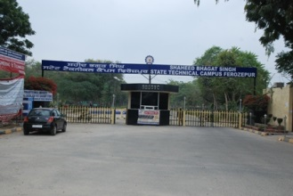
Shaheed Bhagat Singh State Technical Campus

Slide 4
MCA/MBA/BCA Department

Slide 5
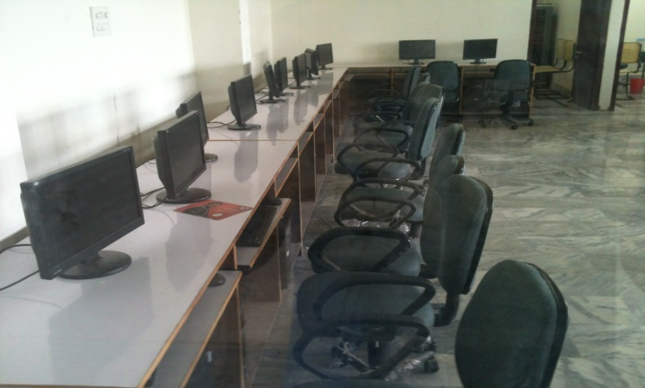
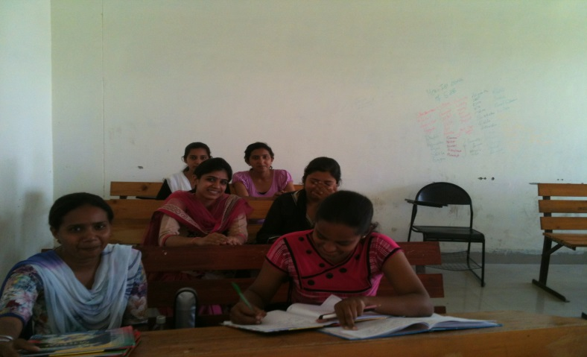
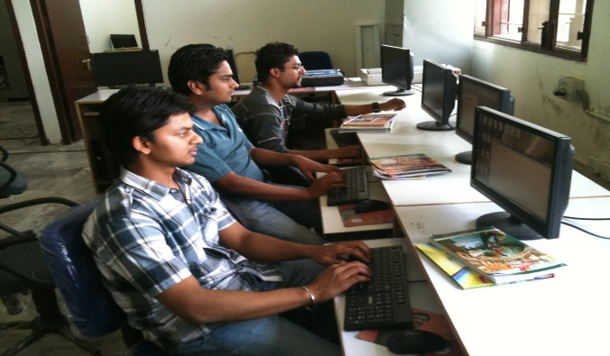
Department Infrastructure
It has 8 lecture halls
4 tutorial rooms
1 conference hall
2 computer labs
Large compound

Slide 6
Lab Infrastructure
The Technical Campus has an well designed, well equipped and centrally air-conditioned Computer Centre.
The Computer Centre has 03 Servers (SQL server, Network Management Server and Windows NT) to which 135 intelligent terminals are connected through AT&T three layered structured cabling.
A laser printer, a scanner, seven Color Inkjet Printers, twenty Dot Matrix Printers, and a number of CD-Writers are the added support to the service of Computer Centre.
The Computer Centre has 34 Mbps (1:1) Leased Line Internet Connectivity through BSNL.
This internet facility is distributed on all the 800 terminals available in the Technical Campus.
The computer centre also provides Wi-Fi connectivity in the campus. The timings of Computer Centre are 8.00 am to 5.00 p.m. throughout the academic session on all week days.

Slide 7
MCA Department Computer Lab

Slide 8
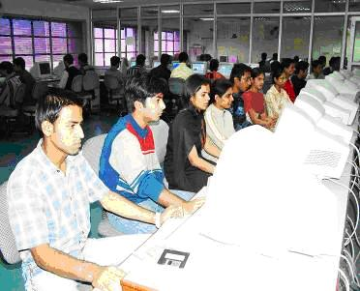
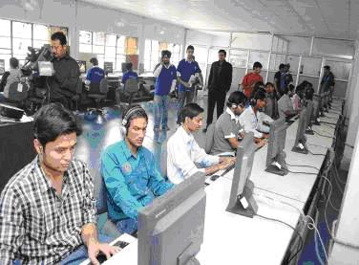
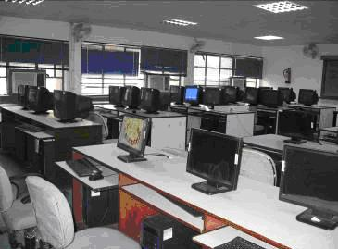
Central Computer Centre
.

Slide 9
Wi-fi Campus
Ergonomically designed, well equipped and centrally air-conditioned Computer Centre
03 Servers (SQL server, Network Management Server and Windows NT)
The Computer Centre has 24 Mbps (1:1) Leased Line Internet Connectivity through BSNL.
Wi-Fi connectivity in the campus
This internet facility is distributed on all the 800 terminals

Slide 10
TEQIP
Technical Education Quality Improvement Programme (TEQIP) is being implemented at SBS by Government of India as a World Bank assisted Project to improve the quality of technical education system in the country.
Strengthening Institutions to produce high quality engineers for better employability.
Scaling-up postgraduate education and demand-driven Research & Development and Innovation.
Establishing Centres of Excellence for focused applicable research.
Training of faculty for effective Teaching.
Enhancing Institutional and System Management effectiveness.

Slide 11
Grant of 10 crores under TEQIP
SBSSTC has got the grant of 10 crore rupees by the centre govt. for the growth of college.
2 crores for the girls hostel.
Free of cost industrial visit for MCA and MBA students.
Free of cost 6 months training for MBA and MCA students in college labs.
Free of cost certification courses for MBA/MCA/BCA/BSC IT students.
Free extra classes for weaker students.

Slide 12
National Knowledge Network
SBS has maintained the NKN that is a sharing Network with IIT’s,NIT’s, IIM’s .With this interlinked network students can share the academics notes, journals, current disscusion topics and recent trends of Information technology with the experts and IIT’s and IIM’s.
The purpose of such a knowledge network is to build quality institutions with requisite research facilities and create a pool of highly trained persons.
The NKN while impacting the existing academic and student community will also alter the R&D landscape for future generations.

Slide 13
Faculty for MCA/MBA/BCA/Bsc(IT)
Mr.Anil Bansal Associate director (HOD MCA) with experience above 15 years.
Dr. R.P. Singh Associate Director (HOD Management) with experience more than 15 years.
4 regular faculty members with qualification MCA and PhD.
10 adhoc faculty members from reputed universities.

Slide 14
Extra courses to be taught for MCA/MBA/BCA/BSC IT students
Animation
Web Designers
Networking
Oracle
Personality Development
Communication skills
Free of cost

Slide 15
Certified Courses for students of MCA/MBA/BCA/Bsc(IT)
Networking classes are conducted at College Labs by CISCO itself and certications are provided by CISCO itself.
Extra classes for hardware are also provided to the students at off hours.
Workshops are conducted by Companies like Infosys,Tech-mahindra, Acccentures , Piford ,and many more companies.
Special Guest lectures by topmost university experts from IIT ,Tech ,PU Chandigarh and Punjabi university Patiala.

Slide 16
Academic Autonomy
College will be declared as the autonomous university in the recent future. In this capacity college will have the power to do the following:-
College will conduct the final papers at its own level
College can change the syllabus any time according to recent technology trends and latest industry requirements.

Slide 17
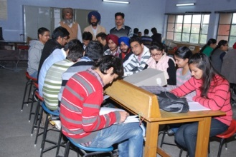
Airy and well lightened Lecture halls and tutorial rooms

Slide 18
Interdepartmental CACA Society COMMUNAL ASSOCIATION OF COMPUTER APPLICATIONS
MCA and MBA students has made “Communal Association of Computer Applications” for the innovative growth of students on technical and non technical aspects both. In CACA students themselves helds monthly one technical and one non technical that builds the self confidence and creativity.

Slide 19
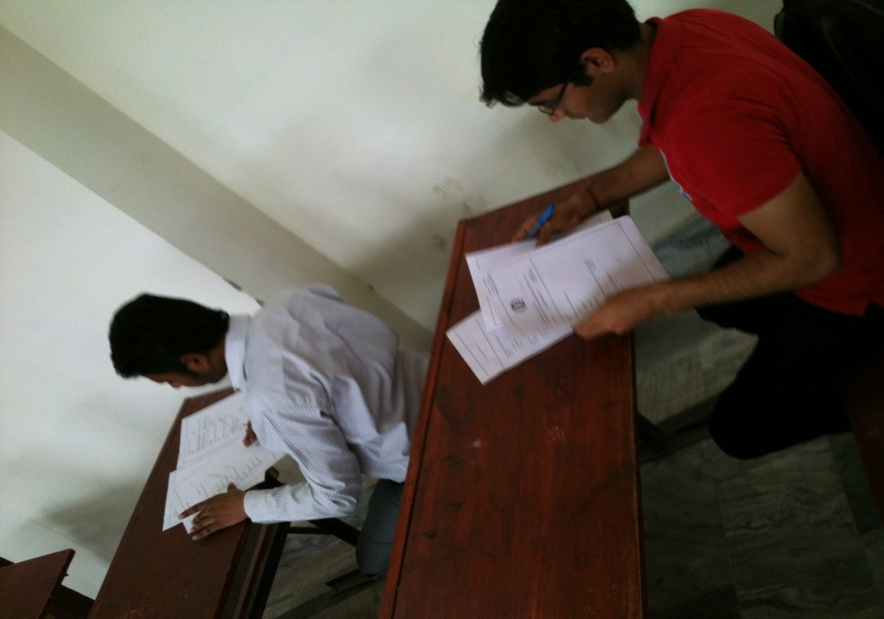
CACA QUIZ held by students themselves

Slide 20
Cultural Events
‘Virsa’ grant annual event of SBSSTC by Polywing department and management department.
‘Jashan’ Grand annual event of SBSSTC by BTECH department.
BCA girls have won the first prize in LOK-FOLK held at Bombay Govt. auditorium.
College has its own NSS unit in which blood donation camps , medical camps , tree plantation etc are organised by the students.

Slide 21
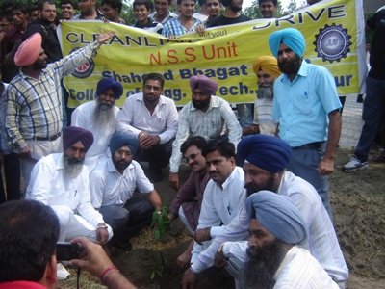
NSS UNIT Activites

Slide 22
Hostels
Three (03) hostels for boys namely Satluj Bhawan, Ganga Bhawan and Beas Bhawan
91 dormitory rooms each with a capacity of 3 to 4 students and 202 double seater rooms.
Two (02) hostels for girls namely Sarswati Bhawan and Mata Gujri Bhawan
29 dormitory rooms each with a capacity of 3 to 4 students and 79 two seater rooms.

Slide 23
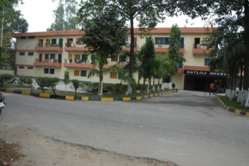
H’ble Techincal minister Anil Joshi laid the foundation stone of Girls Hostel

Slide 24
Academics and sports
Our students has First 10 positions in academic and sports in PTU Jallandhar.
Technical Campus have a vast lush green play' fields measuring 245x245 meter.
In this area playgrounds such as 400 meter, athletic track, hockey ground, basketball ground volleyball, lawn tennis and badminton. The cemented courts are available.
Indoor games like carom, table tennis, chess are available in each hostel.
The Technical Campus has started fitness centre in the campus.
The Technical Campus also plans to have a swimming pool.

Slide 25
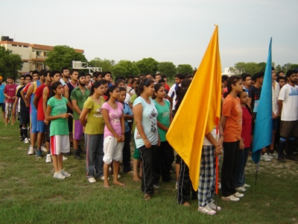
Annual Atheltic Meet

Slide 26
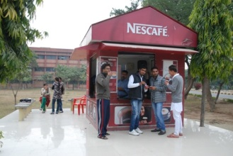
Central Amenities
Shopping complex with grocery shop, a stationary shop, a photo-state shop, a confectionary shop, a barber shop, a dhobi shop and a fruits & vegetables shop.
Canteen Facility and Nescafe Outlet
Gymnasium
Bank and ATM
Post Office
Guest House & Guest Rooms
Dispensary

Slide 27
Library
Library is member of DELNET (Developing Library Networks)
Library is having various section, i.e., Reference Section,Text Book Section, Book Bank Section, Circulation Section, Newspaper, News Letter, Journals, Magazines Section, CD-ROM facility
There is facility of Book Bank for SC/ST students
An air conditioned Reading Hall.

Slide 28
PTU Results:-
MCA 100%
MBA 100%
BCA 95%
BSC IT 95%
Extra classes for Weaker students who have reappears are conducted off time.

Slide 29
Placements
Our students are placed at Tech Mahindra, Infosys, Parrot System, Accenture, L& T Infotech, I-Flex,Satyam,Gujrat Ambuja, Wipro, Nestle, Bluestar,Samsung,videocon,Beta-soft,India glicol and many more.
The college is also making Joint venture with reputed companies for the placements of MBA and MCA.

Slide 30
Campus visit of sonalika tractors for placements

Slide 31
Placements in 2013 Batch

Slide 32
Anti Ragging Campus

Slide 33
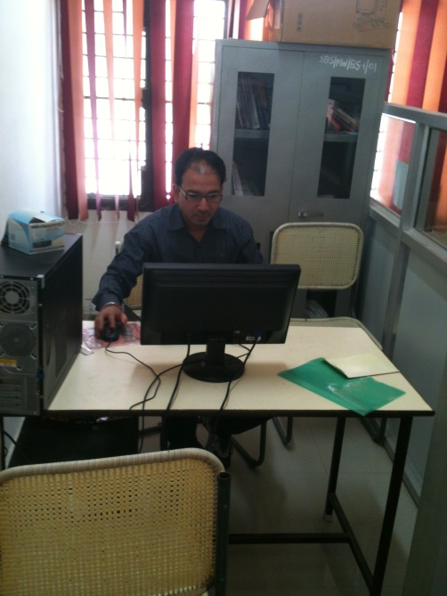
Registration Open
Registration will open on
For any query please contact:-
DR RP Singh HOD MBA 8288012024
MR Anil Bansal HOD MCA 828801206
Mrs Bindu Bala 8146589807
Mrs Nisha Gupta 8146291093
Mr Gulshan Ahuja 8146550540
Mr Rakesh Gupta 9855407673

